Slide 1

Let’s start with Allah Yaar
Bs in Computer Science

Slide 2
ICT (Information and Communication Technologies)
Information and Communication Technologies
Define:
Can be broadly defined as the means of creation, storage, management and dissemination of information by electronic means.
Those technologies that enable the handling of information and facilitate different forms of communication.

Slide 3
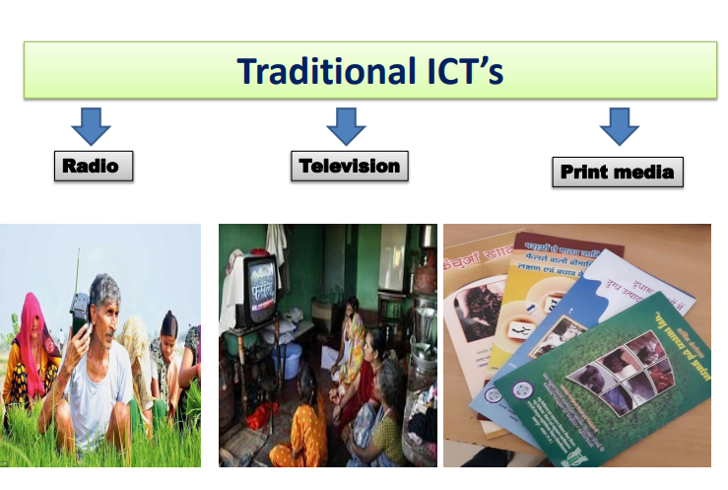
TYPES OF ICT TOOLS

Slide 4
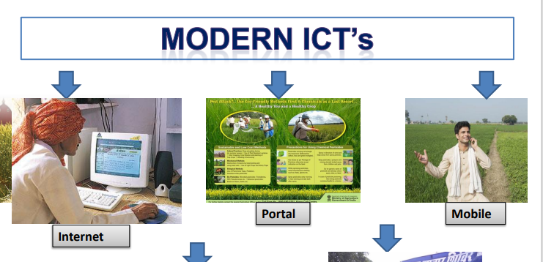
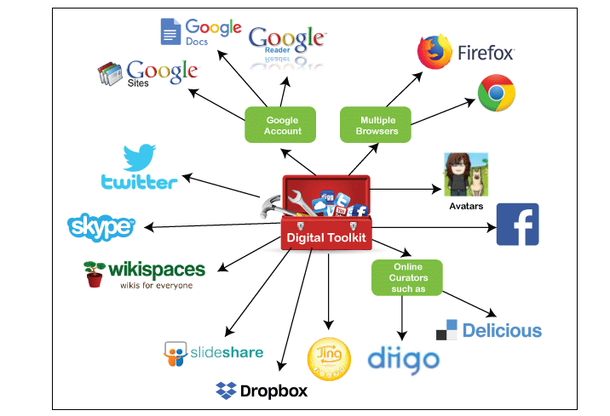
TYPES OF ICT TOOLS

Slide 5
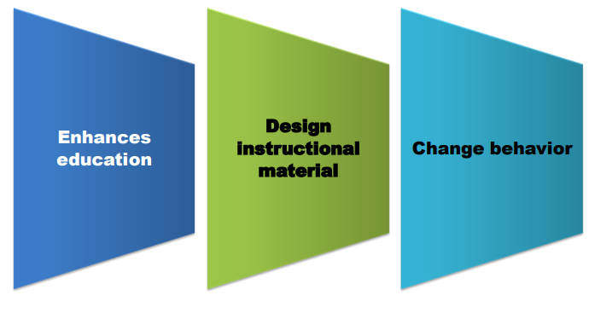
PURPOSES

Slide 6
The Role of ICT in Daily Life
Education and Learning (ICT enhances teaching and learning through e-learning platforms, smart classrooms, and educational software)
Business and Administration (ICT tools such as email, video conferencing, and project management software support efficient communication and collaboration)
Healthcare(ICT enables the storage and analysis of medical data, improving diagnostics and patient care)

Slide 7
The Role of ICT in Daily Life
Banking and Finance (Online banking, mobile payment systems, and ATM machines simplify financial transactions for consumers)
Entertainment and Media (ICT provides platforms for digital media, streaming services, and social media, enabling global content consumption)
Transportation and Navigation (GPS systems, online booking systems for flights and trains)

Slide 8
IMPORTANCE OF USING ICT
Improves learning process
Connects processes and products of instructional design
Improves communication

Slide 9
Exploring the Computer Based Systems
Complex systems in which computers play a major role. While complex physical systems and sophisticated software systems can help people to lead healthier and more enjoyable lives.

Slide 10
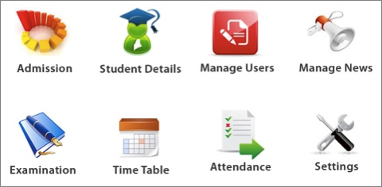
Exploring the Computer Based Systems
School management systems:
School Management Systems are software tools used to manage and store data related to the daily operations of a school. These systems help in handling tasks such as attendance tracking, timetabling, reporting on student performance, maintenance of records, and communication between staff, parents and students.

Slide 11
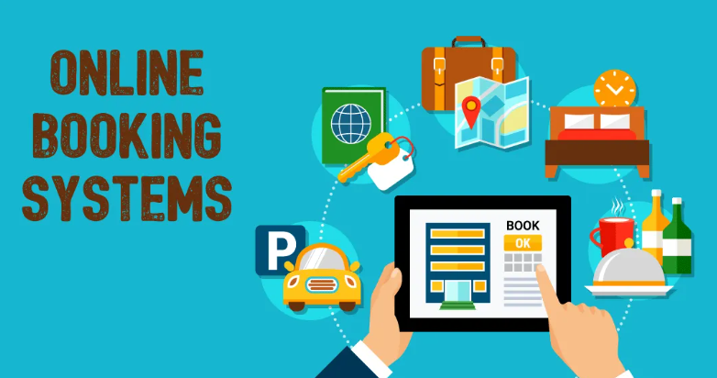
Exploring the Computer Based Systems
Booking systemsSchool Management:
An online booking system is a piece of a software used for reservation management. It allows travel and hospitality businesses to accept bookings online and manage mobile and personal bookings in a better way.

Slide 12
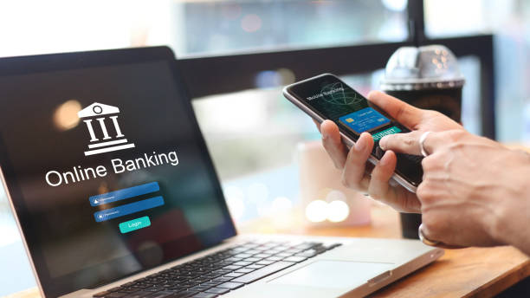
Exploring the Computer Based Systems
Banking applications:
Online banking, also known as internet banking, virtual banking, web banking or home banking, is a system that enables customers of a bank or other financial institution to conduct a range of financial transactions

Slide 13
Computers in medicine
A system based on blockchain technology that ensures secure storage and sharing of medical data.
Doctors also diagnose the disease by the help of scanning devices that is fully based on Computer.
Using ICT doctor can share our research with other doctors.
3D-Printers:
A 3D printer is a machine capable of outputting three-dimensional objects from a digital file
3D printing starts with the creation of a 3D model using computer aided design (CAD)

Slide 14
Expert systems
Expert systems are software programs that can make decisions and draw conclusions, similar to a human.
Expert systems have two main components:
(a) knowledge base
(b) inference engine
knowledge base:
A database that contains facts provided by a human expert and rules that the expert system should use to make decisions based on those facts

Slide 15
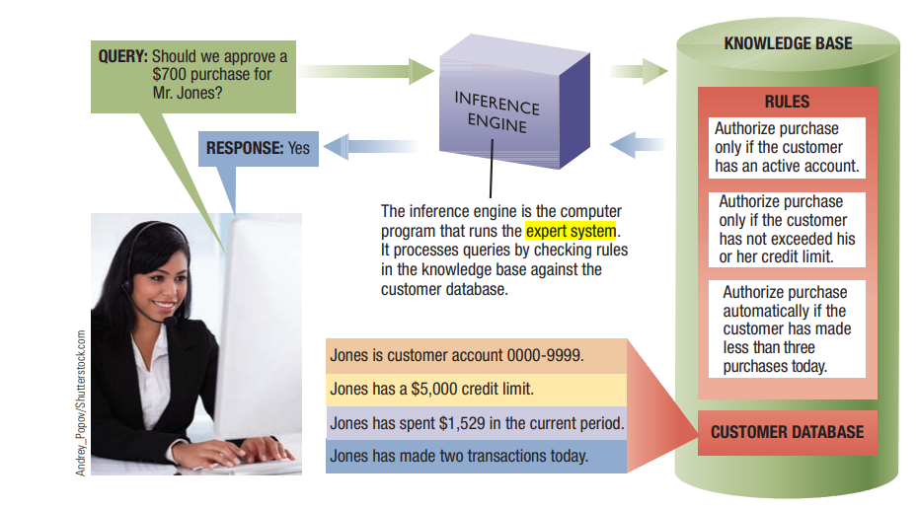
Expert systems
Inference engine:
A software program that applies the rules to the data stored in the knowledge base in order to reach decisions

Slide 16
Computers play a crucial role in the retail industry
Here are some key areas where computers and ICT impact retail
Point of Sale (POS) Systems.
Inventory Management
Customer Relationship Management (CRM)
E-commerce Platforms
Marketing and Advertising
Automation

Slide 17
Recognition systems
Recognition systems in the context of Information and Communication Technology (ICT)
Biometric Recognition
Object Recognition
Gesture Recognition
Emotion Recognition
Optical Character Recognition (OCR)

Slide 18
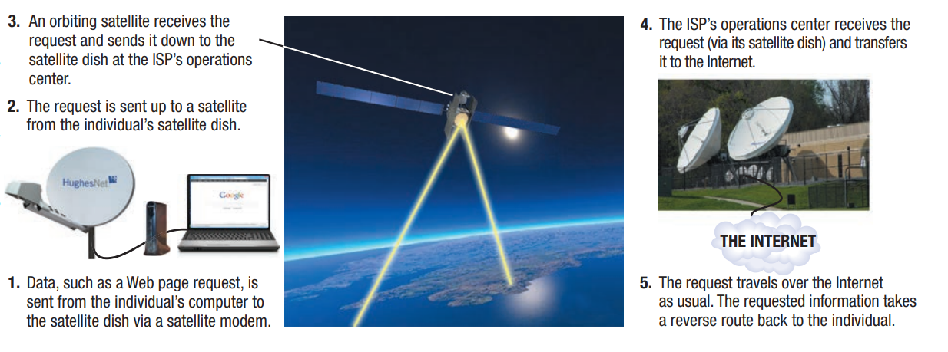
Satellite systems
Communications satellites are space-based devices launched into orbit around the earth to receive and transmit microwave signals to and from earth

Slide 19
Types of Satellite systems
Communication Satellites (facilitates telecommunication, broadcasting, and internet services). LEO (low earth orbit satellite)
Earth Observation Satellites (Collect data for weather forecasting)
Navigation Satellites (Provide GPS services for location tracking)

Slide 20
Thank you so much

